Slide 1
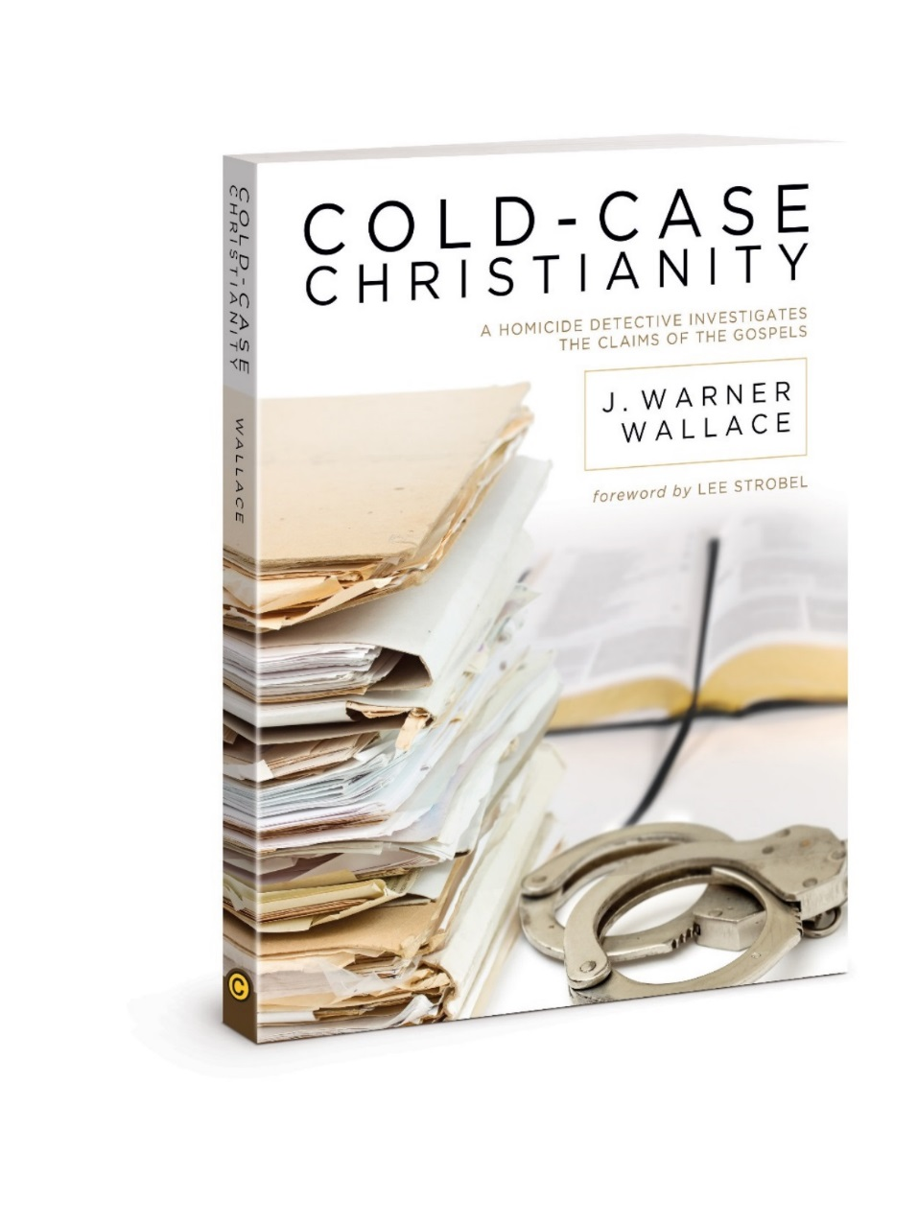
Chapter 3
Think Circumstantially
Notes:
For these next 4 chapters, we are going into the evidence

Slide 2
Circumstantial Evidence
Will review -what it is -What it’s good for -Where we commonly see it used

Slide 3
Circumstantial Evidence
Two types of evidence: Direct Indirect (circumstantial)

Slide 4
Think Circumstantially
Circumstantial evidence often very interpretive
1 piece interpreted multiple ways
The more you have, the clearer the story
One can corroborate(agree/build-up) the other
Notes:
-Often very interpretive: ie.)The murderer may have been sighted with a yellow car, but that doesn't mean every person who has a yellow car is the murder suspect.

Slide 5
Direct vs. Circumstantial Evidence
Direct: can prove something all by itself ie.)truthful witness testified that it was raining
Indirect: (aka circumstantial) proves nothing by itself. Ie.)truthful witness testifies seeing someone enter with a raincoat covered in drops of water is circumstantial evidence it was raining outside.

Slide 6
Circumstantial Evidence
For each piece...
If you can draw two or more reasonable conclusions from the same circumstantial evidence, you must accept the conclusion that points to innocence
You must accept only reasonable conclusions
Notes:
(comes from CA jury instructions. Section 224, Judicial Council of California Criminal Jury Instructions, 2006)

Slide 7
Think Circumstantially
Jurors in courtrooms are instructed to make no distinction between direct and indirect(circumstantial) evidence in a case.
Both are considered as acceptable types of evidence.
There are many cold cases for murder that are solved with only circumstantial evidence
Circumstantial evidence is usually not powerful with just one piece alone, but with many pieces of circumstantial evidence, they can be very compelling

Slide 8
A juror is asked to determine your decision on what is reasonable, not what is possible
Direct evidence for God could be witnessing creation, which no human has
We rely on human witnesses and circumstantial evidence to solve murder cases that had no eyewitnesses; will use same principles on the gospel accounts
Notes:
1.)When a court case is determining whether someone is guilty of murder, the jury should make sure it makes a decision based on the evidence and not a bunch of speculation. That decision may determine the lifetime fate of a human being. -Analysis of the gospel accounts has much stronger implications, if trustworthy and true 3.)we are going to piece together circumstantial evidence to show that Jesus was resurrected

Slide 9
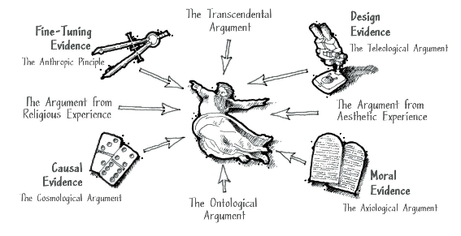
Circumstantial Evidence when put together stronger than alone
Notes:
-This is an example of what circumstantial evidence looks like when added together
-We could have a whole series on any one of these given topics, but the idea is to demonstrate how circumstantial evidence, when pieced together, can become very powerful.
-Keep in mind that all the evidence in the world will do not good for someone who has made a volitional decision to ignore the evidence. The ontological argument for the existence of God refers to the claim that the very logical possibility of God’s existence entails his actuality.
-Causal - Nothing in our universe has ever been observed to cause itself to exist.

Slide 10
for more information visit:
www.ColdCaseChristianity.com

